Slide 1
CAR 163916189 - Finding

Slide 2
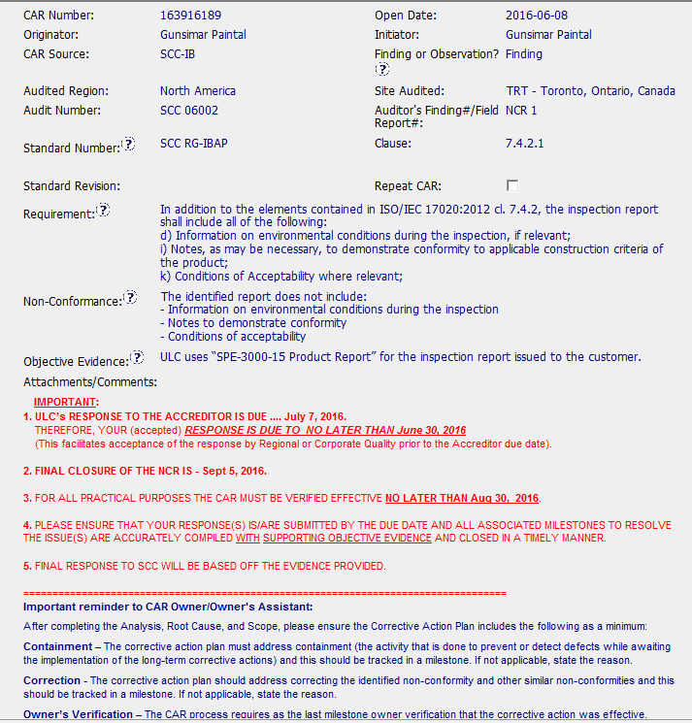
Critical discussion with AHJ’s resulted in two milestone essentially not completed. Would have been helpful to summarized under “Comments”
CAR guidance was very clear, including key dates and CAR reminders

Slide 3
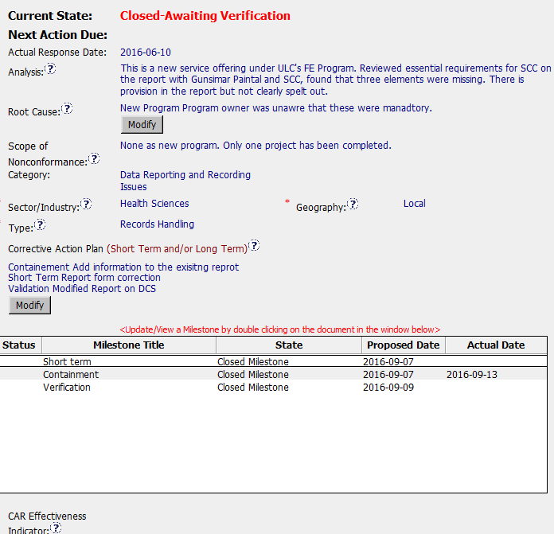
Analysis included discussions with key stakeholders, including the SCC.
Analysis essentially restates the non-conformance. There was no indication of any analysis method used (i.e. 5 why’s etc.). Analysis indicates that the three elements were missing from the report but fails to identify why staff were not aware of the standard requirement cited in the CAR.
Scope of defect was considered.
Corrective action does not specifically address the Root Cause, e.g. Program owner was not aware report requirements were mandatory.
The Analysis does not logically lead to the stated Root Cause, i.e. why was the program owner not aware that certain components identified in the standard were not included in the report.
Appears that two milestones were not completed.

Slide 4
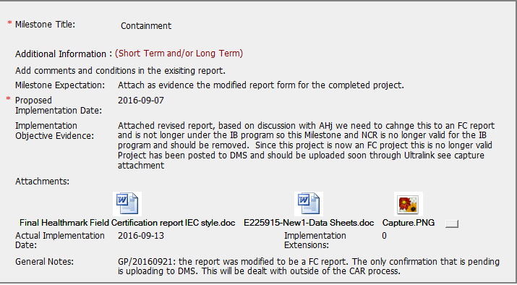
Discussions with AHJ changed focus of Corrective Actions and ultimately, how the CAR was managed moving forward. Clarifications under the “Comments” section would be helpful in understanding how the CAR was ultimately resolved.

Slide 5
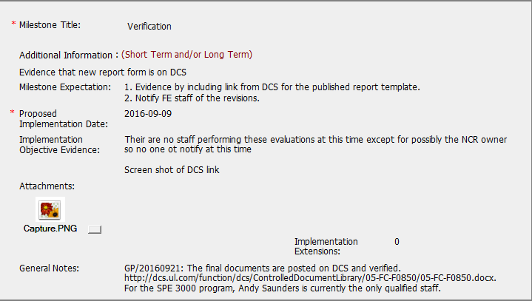
Verification step does not specially provide objective evidence that the Corrective Action has mitigated the reoccurrence of the defect.

Slide 6
CAR Champ provided direction to CAR owner when implementation was not accepted.
Additional comments concerning change of CAR focus would have been helpful
CAR Champ provided support to CAR owner and was a stakeholder that was part of analysis.
Clear path from Analysis to Root Cause could have include more detail
Good feedback to CAR owner when milestone implementations were returned.

Slide 7
CAR 163916189 Finding

Slide 8
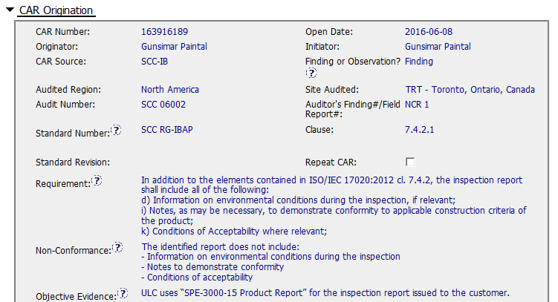
CAR 163916189
Finding - CAR
Background: SCC- “The identified report missed several items.”

Slide 9
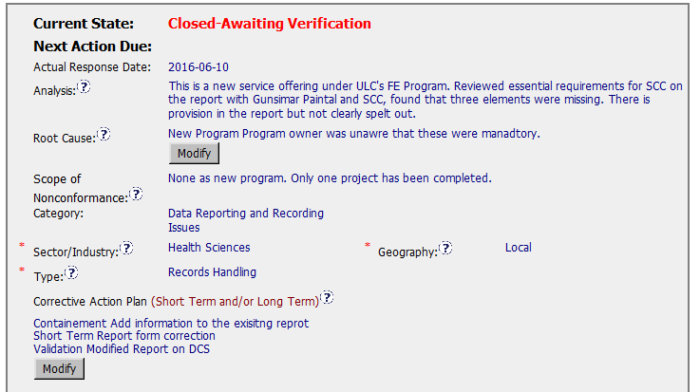
CAR 163916189 Analysis
Suggestion (1)
Analysis:
The sentence seems like nonconformance.
Analysis should get the right people involved and use a method to analyze the problem .
Suggestion (2)
Root Cause:
Should be linked to the analysis , and this root cause requires more investigation.

Slide 10
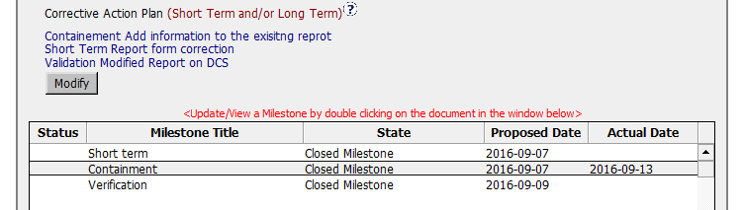

CAR 163916189 Milestone and History Summary
Suggestion (3)
1) It is better to set different date of each milestone, containment and short tem propose date of this CAR are the same.
2) Though CAR owner put all the evidence for each milestone, CAR Administrator still need to approve each milestone step by step. From the history we can see CAR administrator approved the containment and closed whole CAR.
Suggestion (4)
Extension should be less than 30 days.

Slide 11
CAR 163916189 – CBS Check
CBS Requirements | Excellent | Moderate | Need Improve | N/A
(C) Extensions are within requirement (<30 days, 3 or less) |  |  | √ with Suggestion
(T) Most appropriate ‘category’, ‘type’, ‘geography’ are selected | √
(P) Facilitates the handling of disputed CARs |  |  |  | √
(T) Acts on CARs within required timeframe |  |  | √ with Suggestion
(C) Analysis shows clear path to root cause and scope; stakeholders identified |  |  | √ with Suggestion
(C) Root cause statement is succinct, reasonable, complete (Shows ‘N/A’ for observations) |  |  | √ with Suggestion
(C) Corrective actions fix the objective evidence and other problems found; address entire root cause and scope. For observations, they do not go beyond fixing the objective evidence | √
(C) Milestones address containment & owner’s verification; completed per milestone expectations | √
(P) Verification per requirements | √
(L) Referenced communications are attached as needed |  |  |  | √
(C L) Evidence of communication for overdue/escalated CARs and other pertinent concerns |  |  |  | √
(P) Trains other CAR Champions |  |  |  | √

